Slide 1
Statistical Foundations for DS
Nombre Completo Formador
Nombre.apellido@bts.tech

Slide 2

Project Lifecycle
DEFINE data-driven opportunities based on business value creation
UnderstandBusiness
IMPLEMENT & OPTIMIZE data-driven business models
Data collection
IDENTIFY, transform and validate data
Exploit
To lead and manage Big Data projects
Smart
Data
Analysis & Visualization
DEVELOP & TRAIN intelligent data algorithms
DEVELOP analytical and data visualization techniques

Slide 3
Project Lifecycle
Data-Driven Business
Creative Technology
Entrepreneurship
Big Data legal & Security
Agile
UnderstandBusiness
Data-Driven Business
Data Science Foundations
Infrastructure
Real-time Data Analysis
Big Data legal & Security
Agile
Data-Driven Business
Advanced Data Analysis
Infrastructure
Real-time Data Analysis
Big Data legal & Security
Agile
Data collection
Exploit
To lead and manage Big Data projects
Data-Driven Business
Data Visualization
Advanced Data Analysis
Artificial Intelligence
Infrastructure
Big Data legal & Security
Real-time Data Analysis
Agile
Smart
Data
Analysis & Visualization
Data-Driven Business
Data Science Foundations
Classical Data Analysis
Infrastructure
Real-time Data Analysis
Big Data legal & Security
Agile

Slide 4
Statistical Foundations for DS
What we will learn
We will learn:
Probability foundations
Distribution of random variables
Inference foundations, numerical and categorical
Introduction to regression techniques
Notes:
Infer: Drawing conclusions about a population using information about a sample

Slide 5
Student Experience
Industry congresses
Meetups
Keynotes
Visits to companies
BTS DEMO
DAY
DIGITAL ECOSYSTEM
EXPERIENCE
A
ACADEMIC EXPERIENCE
B
Z
20%
100%
OF THE STUDENT EXPERIENCE
OF THE STUDENT EXPERIENCE
WORK ON YOUR PURPOSE - RESEARCH – DISCOVER –
BUILD NETWORKING – JOIN COMMUNITIES –
PARTICIPATE – GENERATE PUBLIC CONTENT

Slide 6
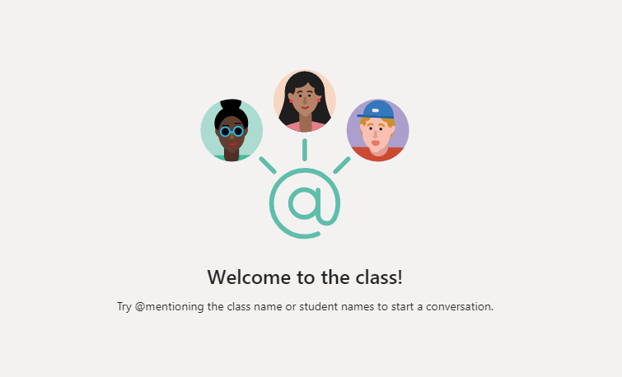
Curriculum review

Slide 7
Today’s Objective
Objective and why it is useful in a digital project

Slide 8
What is Data Science?
Intersection between Stats, IT, and Business

Slide 9
Process of Investigation
Identify a question or problem
Collect relevant data on the topic
Analyze the data
Form a conclusion

Slide 10
Stats Focuses On:
Collect
Analyze
Infer
Predict/Explain

Slide 11
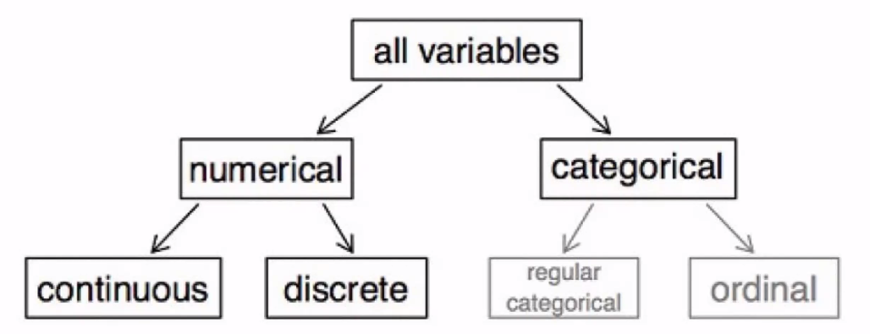
Types of Variables
Continuous: can always add another decimal to the figure
Categorical: Descriptive, not numeric (obviously)
Regular categorical: No inherent order to the categories (like colors)
Ordinal: Has a natural order (ex. Highest level of education, age group demographic, etc)

Slide 12
Associated vs. Independent
Associated/Correlated:
Correlation is for numeric variables, ex. Height correlates with weight
Associated is for categorical, ex. Smoking and risk of dying (also used if we’re talking about a cateogrical vs a numeric, such as associating height and weight)
Independence:
Knowing something about one variable gives you no information about a second variable

Slide 13
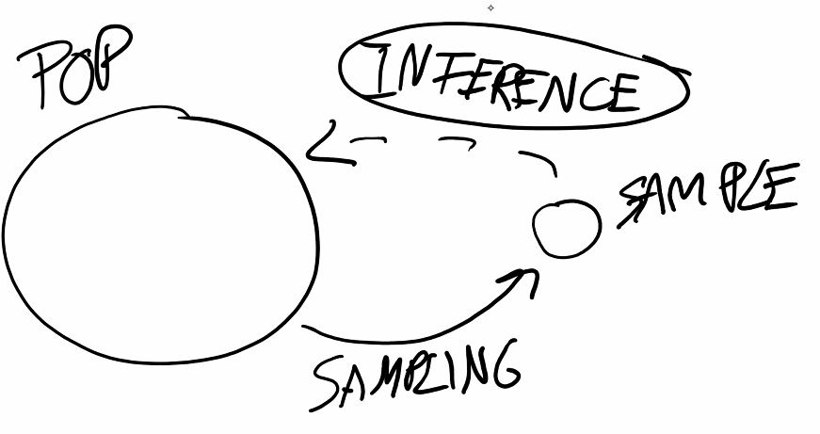

Terminology
Collecting Data: Sample data from population
Explanatory vs. Response
Explanatory = Independent
Response = Dependent
“Association/Correlation does not implay causation.”
Confounding variable: Something “behind the scenes” that is confusing conclusions
Example: there’s a good correlation between the amt. Of chocolate consumed annually by a country, and the number of Nobel prizes won by that country. The confounding variable is the wealth of the country.
Experimental Design:
Control
Randomization
Replication
Blocking

